Slide 1
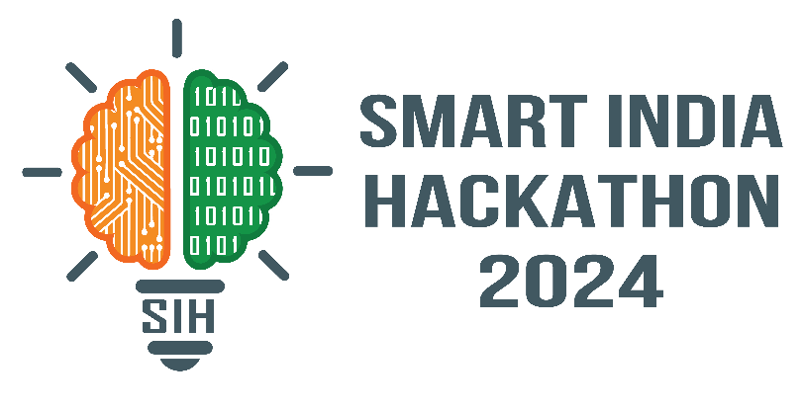
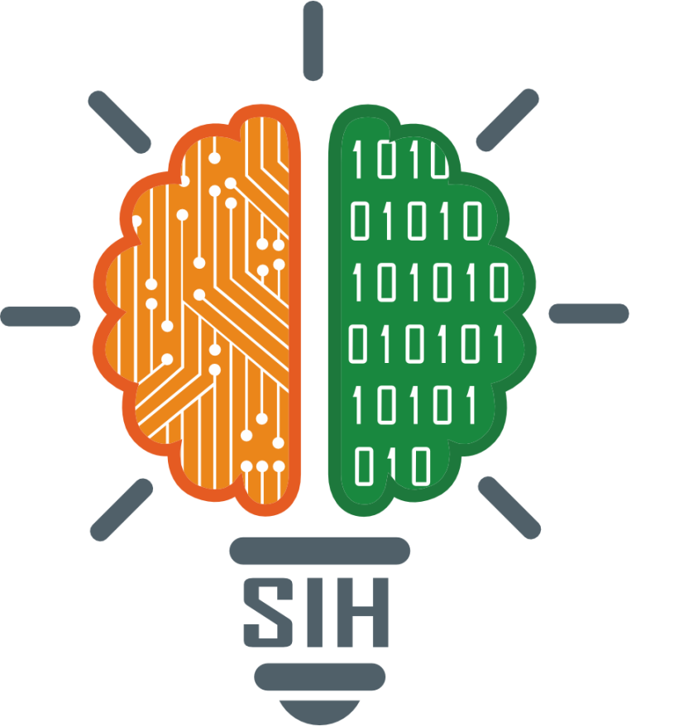
SMART INDIA HACKATHON 2024
TITLE PAGE
Problem Statement ID:
SIH1716
Problem Statement Title:
Indian Sing Language to Text/Speech translation
Theme:
Miscellaneous
PS Category:
Software
Team ID-
Team Name (Registered on portal) :
Sorcerer’s Source Code

Slide 2
IDEA TITLE
Your Team Name
Proposed solution:
Real-time translation of Indian Sign Language (ISL) into text and speech.
Utilizes computer vision and machine learning for accurate gesture recognition.
Supports translation in multiple Indian languages, facilitating broader communication.
Detailed Explanation:
Gesture Recognition: Employs deep learning models to identify ISL gestures in real-time.
Text Translation: Maps gestures to corresponding text, supported by NLP for context.
Speech Output: Converts text into speech in multiple Indian languages.
User Experience: Customizable UI with accessibility features.
Innovation and uniqueness of the solution:
Comprehensive ISL Support: Covers a wide range of gestures.
Real-time Processing: Ensures smooth and accurate communication.
Contextual Understanding: Uses NLP to generate meaningful translations.
Personalization: Allows users to train the system for personalized accuracy.

Slide 3
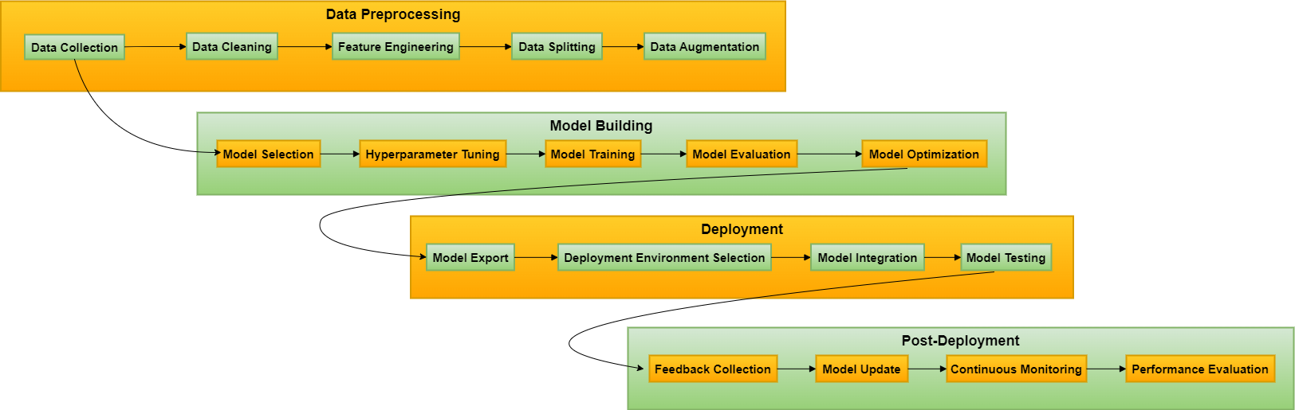
TECHNICAL APPROACH
Your Team Name
Technologies to be Used:
Programming Languages: Python | Frameworks: TensorFlow, OpenCV | Hardware: Camera (for gesture capture)

Slide 4
FEASIBILITY AND VIABILITY
Your Team Name
Analysis of the feasibility of the idea:
Technical: Leverages existing ML frameworks and widely available hardware.
Economic: Cost-effective as it runs on standard smartphones/computers.
Scalability: Can be expanded to include more gestures and languages.
Potential challenges and risks:
Challenge: High accuracy in diverse lighting and background conditions.
Risk: Misinterpretation of complex gestures.
Strategies for overcoming these challenges:
Solution: Continuous model training and incorporating background noise filters.
Risk Mitigation: User feedback loop for error correction.

Slide 5
IMPACT AND BENEFITS
Your Team Name
Potential impact on the target audience:
Target Audience: Deaf and hard-of-hearing community, educators and caregivers.
Social Impact: Bridges communication gaps, enabling better integration.
Economic Impact: Reduces the need for human interpreters, saving costs.
Benefits of the solution:
Social: Increases inclusivity in education, employment, and daily life.
Economic: Affordable solution accessible on widely available devices.
Environmental: Digital, minimizing the need for physical resources.

Slide 6
RESEARCH AND REFERENCES
Your Team Name
Dataset of the project:
https://www.kaggle.com/datasets/prathumarikeri/indian-sign-language-isl

